Slide 1
How to Manage your Intel® Partner Alliance Storefront
Intel® Partner Alliance Solutions Marketplace

Slide 2
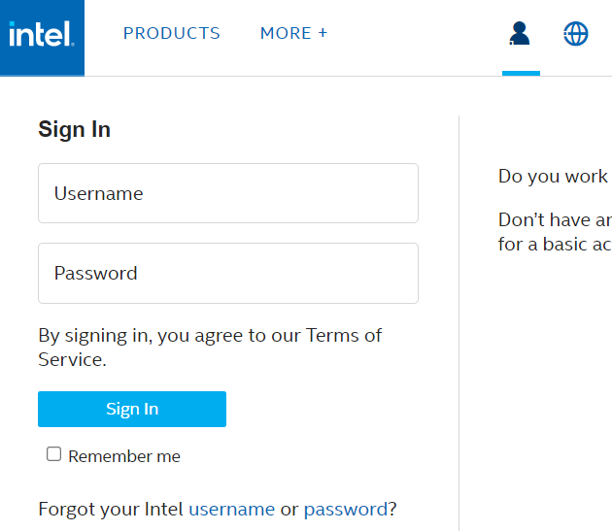
Sign into Intel® Partner Alliance Solutions Marketplace
Click on the chess pawn at the top of https://marketplace.intel.com and sign in with your username and password.

Slide 3
Managing your Storefront
Once signed in, click on Manage Storefront.

Slide 4
Managing your Storefront
Click the pencil icon to the right of your company name.

Slide 5
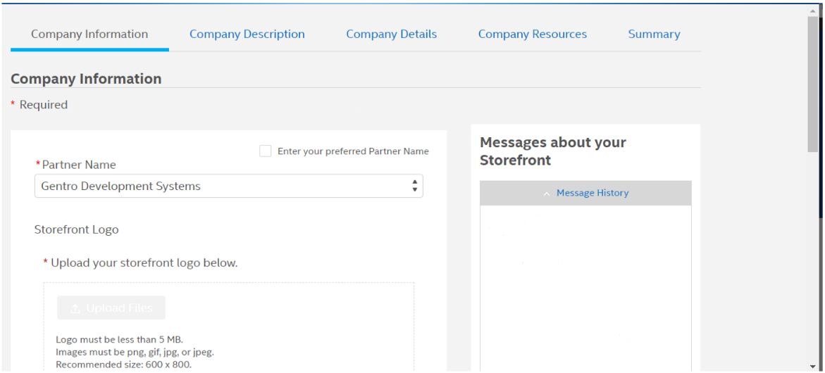
Updating your Company Information
Enter your Company Information on the first page (don’t forget to scroll with the scroll bar on the right), then click the Company Description Tab and do the same. Repeat for the remaining three tabs (Company Details, Company Resources, and Summary).

Slide 6
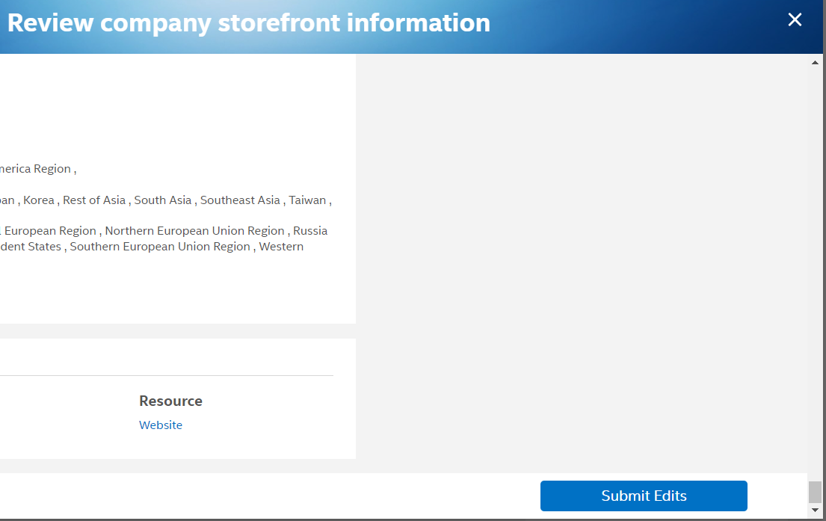
Review and Submit
Click Submit Edits in bottom right corner once you’ve verified all 5 tabs are completed.

Slide 7
How to Edit your Intel® Partner Alliance Offerings
Intel® Partner Alliance Solutions Marketplace

Slide 8
How to Edit an Offering
Click on the chess pawn at the top of https://marketplace.intel.com and sign in with your username and password.

Slide 9
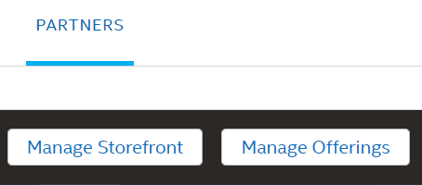
How to Edit an Offering
Once signed in, click on Manage Offerings.

Slide 10
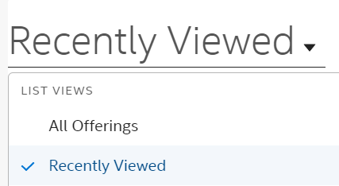
How to Edit an Offering
Change the view to All Offerings.

Slide 11
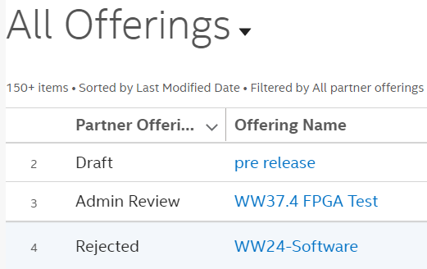
How to Edit an Offering
Click on the name of the offering that you’d like to edit.

Slide 12
How to Edit an Offering
Choose to Edit Offering.

Slide 13
How to Edit an Offering
You can then click on the various sections along the top or just click back or next.

Slide 14
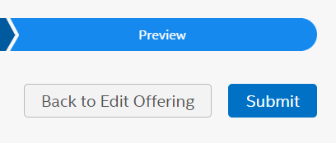
How to Edit an Offering
When you are all done editing the offering, click submit.

